Slide 1


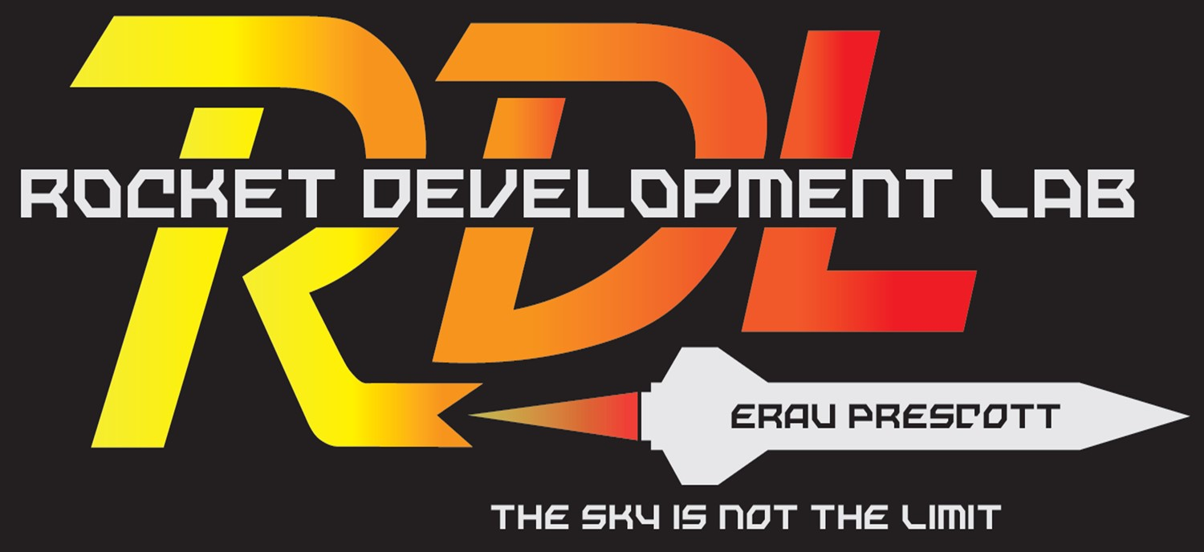

The Effects of Equivalence Ratio During Shutdown of a Rocket Engine on Hardware Longevity
Benjamin Black
Dr. Elliott Bryner
2022 Arizona Space Grant Symposium
April 23rd, 2022

Slide 2
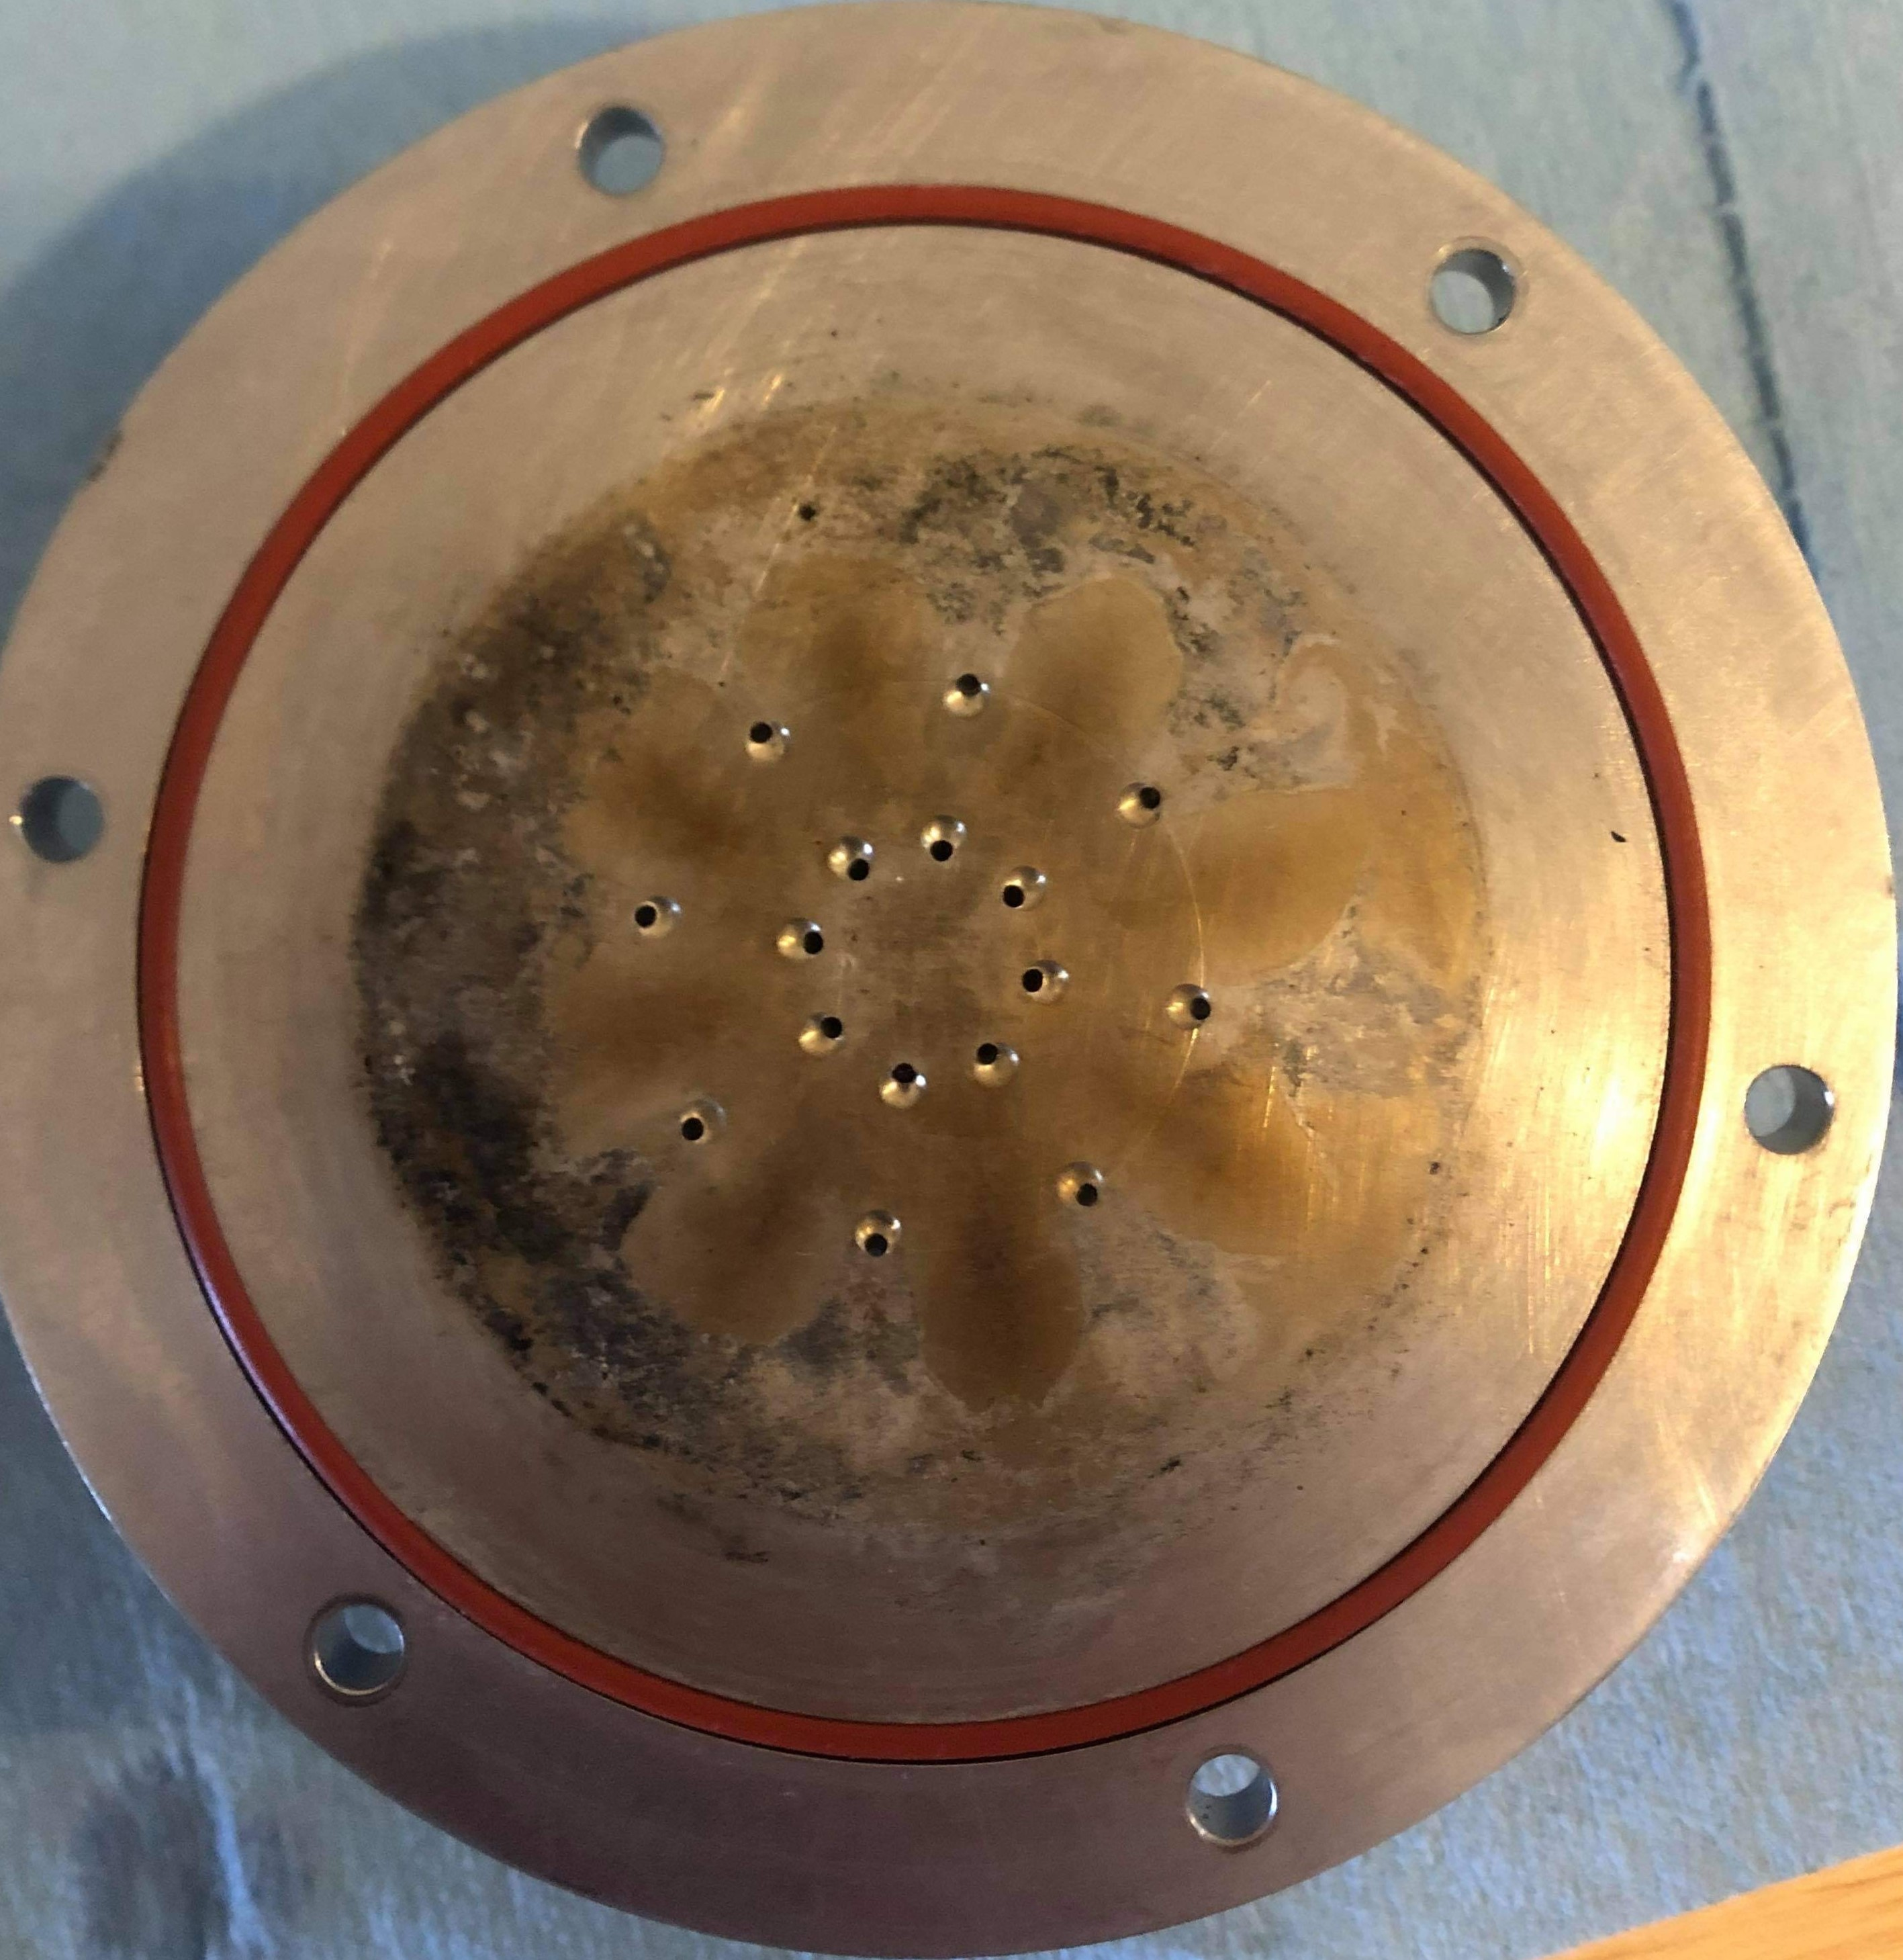

The Problem
During shutdown, oxidizer and fuel flow varies widely
This causes the temperature to spike
It also causes rapid pressure fluctuations
Unpredictable and extreme conditions in the engine lead to damage

Slide 3
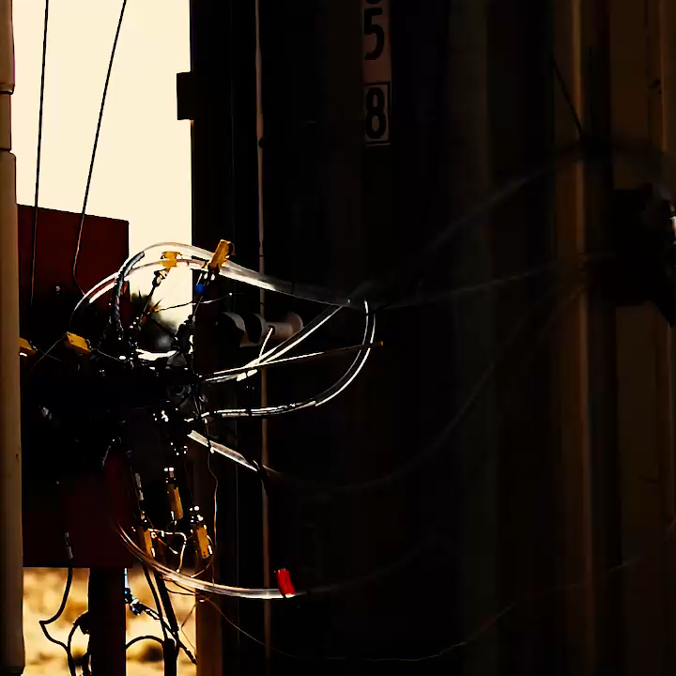
Testing Goals
Isolate the events that contribute to temperature and pressure fluctuations
Determine the exact sequence of events to prevent these conditions
Implement on full scale engines

Slide 4
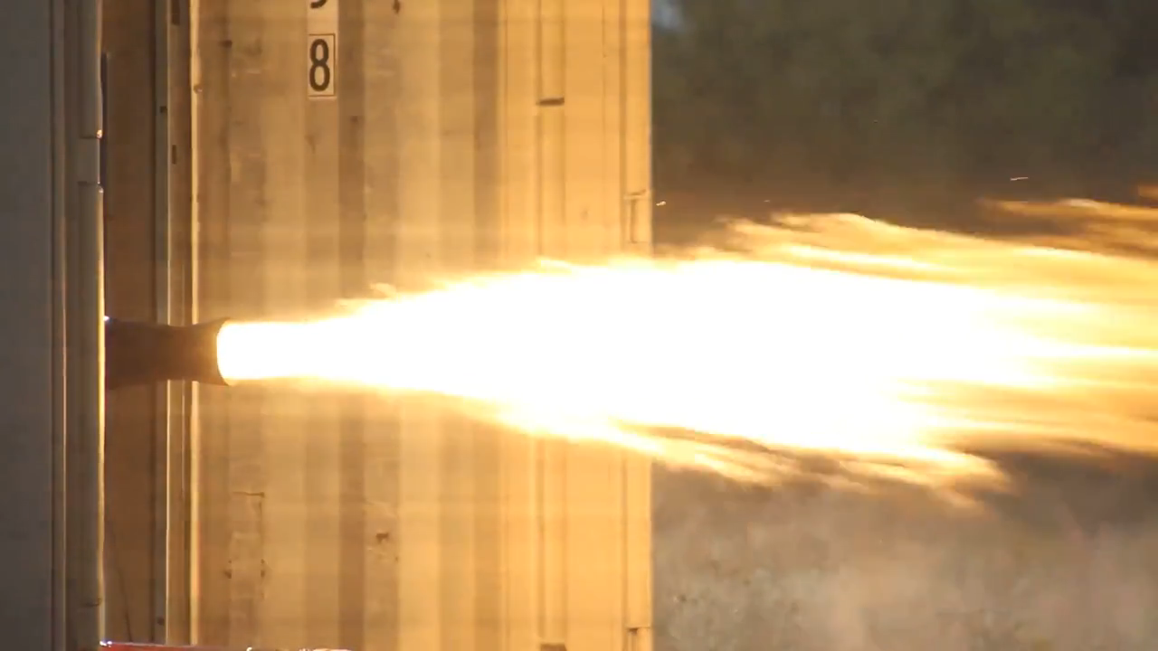
Benefits
Notes:
In depth combustion & thermo-chemistry education
New test hardware for the propulsion testing complex
Increased test team safety
Better test hardware durability and longevity

Slide 5
Methods
NASA CEA Analysis Results
Notes:
Initially a model of flame temperatures as well as reaction products was used to determine the best fuel gas to use for a scale test.
Then NASA CEA was employed to create a model of the flame temperature with mass O/F ratio.

Slide 6
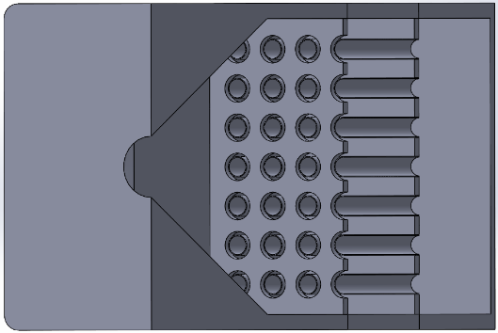
Methods
Notes:
The testing method used is scale gaseous burner testing with a converging-only combustion chamber

Slide 7
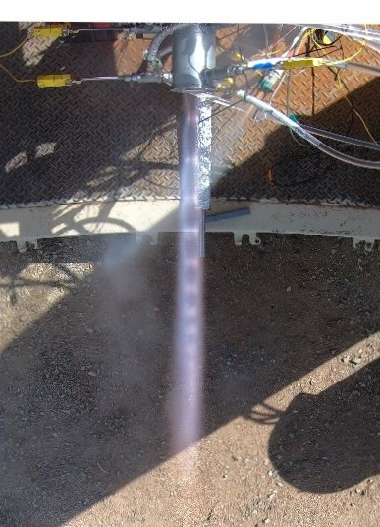
Future Progress
Finish the manufacturing and assembly of the gaseous scale testing fixture
Conduct testing and analyze data for scalable outcomes
Verify results at full scale on the Kairos liquid rocket engine

Slide 8
Acknowledgements
Arizona Space Grant through the Undergraduate Research Institute
The students Rocket Development Lab
The Rocket Development Fund
College of Engineering at Embry-Riddle Aeronautical University – Prescott

Slide 9
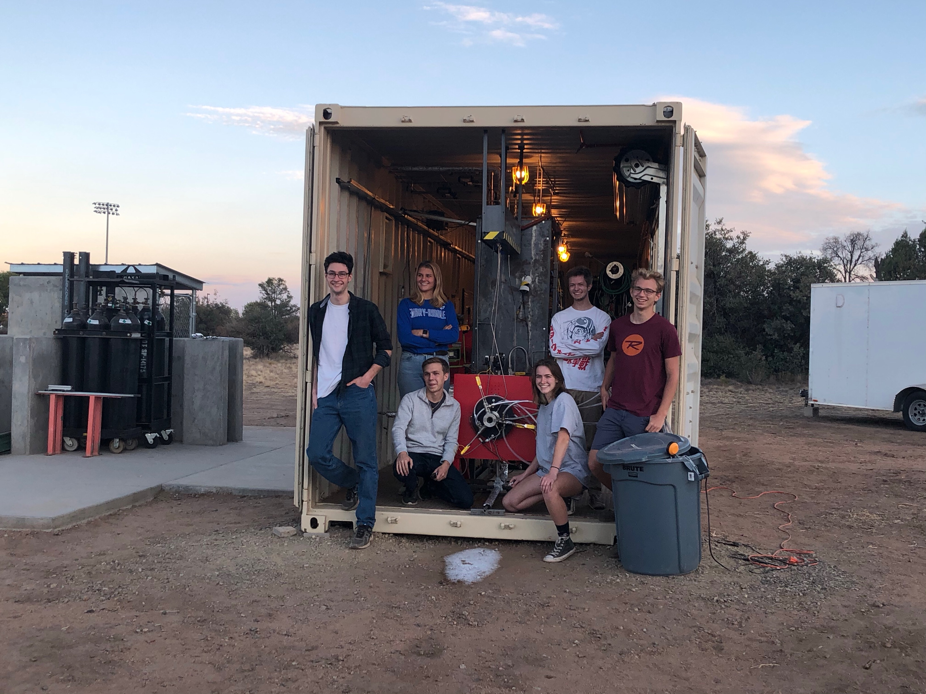
Thank You for Listening
Questions?

Slide 10
Appendix A: CEA Entry Parameters
Rocket Engine approximation
50 PSIA
Pure O2, Pure C3H8 (Propane)
O/F mass ratio from 1-7 by 0.2 steps
Area Contraction Ratio of 56
Area Expansion Ratio of 1
Shifting Equilibrium Expansion
Mdot/Area of .002 lbm/s*in^2

Slide 11
Appendix B: General Trends
 | Fuel-Rich | Ox-Rich | Simultaneous
Pros | Cooler- The flame is generally fuel rich to begin with so, this prevents passing through an equivalence ratio of 1. | Safer- No risk of cryogenic propellants staying long enough to pose a hazard. | Easy- Shut both fuel and Ox off together and let the purge sort it out.
Cons | Dirty- Causes ‘coking’ of the engine. Risk Unburned Fuel- There is a risk of unburned propellant being present as test team approaches posttest and causing an air-fuel explosion. | Hotter- Passing from fuel-rich to Ox rich may cause a momentary spike in chamber temperature and pressure which damages or degrades the test article. Ox Damage- A high temperature, oxygen-rich environment tends to oxidize materials rapidly, damaging components. | Hotter- Because the flow of propellant is now governed by purge pressure and injector geometry Ox will purge faster and create a temperature spike. Combustion instability- Because of the loss of flow control the combustion also becomes unstable and causes significant resonance or “popping”.

